Slide 1

From Data to Action:
Decision Science for Accelerated Business Results
Kadir Karakus, Head of Data at Echo Analytics
www.echo-analytics.com
Proprietary + Confidential
Notes:
Navigating Cinema Advertising with Geospatial Data

Slide 2

Who am I?
Kadir Karakus
Head of Data at Echo Analytics

Slide 3
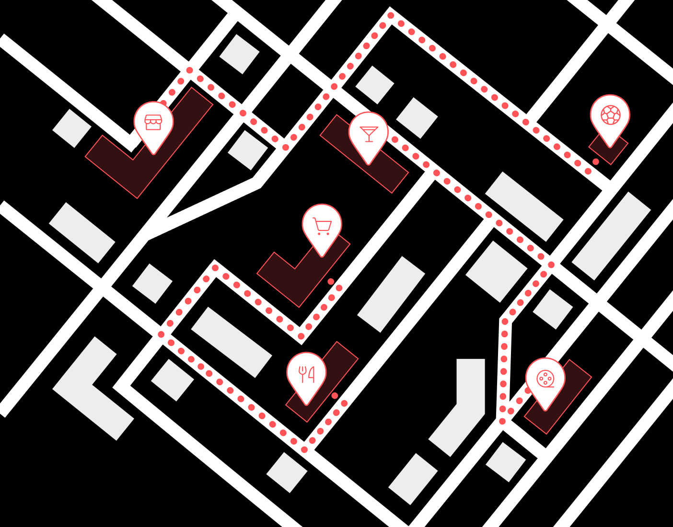


Location Intelligence provider, helping companies solve complex business questions using reliable geospatial insights.
Echo Analytics.
Location Intelligence provider, helping companies solve complex business questions using reliable geospatial insights.

Slide 4
What’s in it for you?
01.
Geospatial data is everywhere
How to make a good decision based analysis?
02.
Everyone is data driven but…
54% of Marketing Leaders think Analytics has not had the expected impact
Low impact projects are a major source of dissatisfaction among data practitioners
How to improve the impact of my data project?
03.
Some theory, Framework, and Use Cases

Slide 5
Decision Science 101
01.
Proprietary + Confidential

Slide 6
Three pillars of Decision Making.
1
2
3
WHAT DO YOU WANT?
WHAT CAN YOU DO?
WHAT DO YOU KNOW?
What is your strategy?
What are you trying to achieve?
What are my options?
Do I have the right resources?
What is the information I need?
Is it reliable?

Slide 7
Three pillars of Decision Making.
1
2
3
WHAT DO YOU WANT?
WHAT CAN YOU DO?
WHAT DO YOU KNOW?
Once we know what we want, we can choose between the alternatives, considering the information we have

Slide 8
Use Case
Proprietary + Confidential

Slide 9
Making a choice.
Imagine you work for a Fast food chain, which project should be your first priority?
A
Using POI and Polygon data to find the best location for your next shop opening.
B
A/B testing to find the best mascot between a unicorn and a cat.
C
Using Mobility data and Transaction data to reduce customer churn.

Slide 10

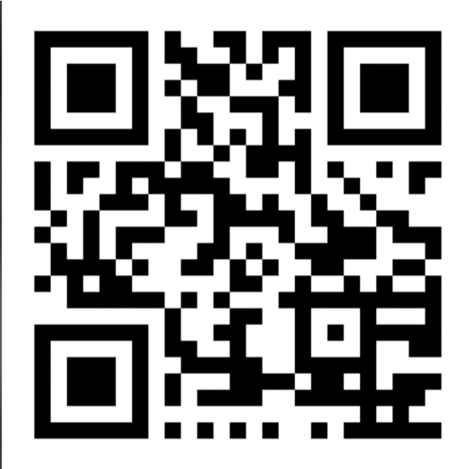
Making a choice.
http://etc.ch/FgQP

Slide 11
Making a choice.
Imagine you work for a Fast food chain, which project should be your first priority?
Knowing the company’s goal is to have A NEW MASCOT

Slide 12

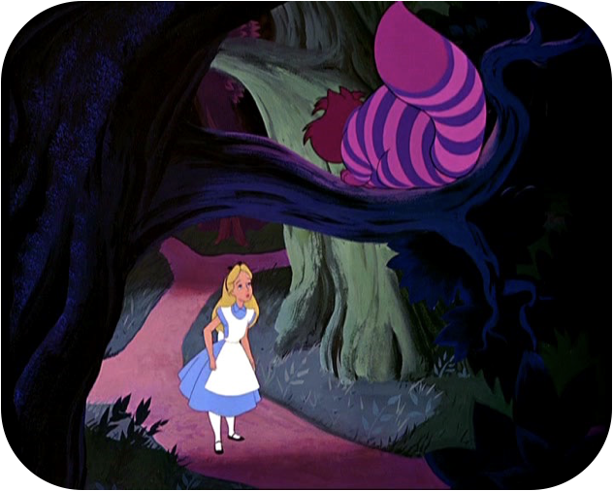

1
What do you want?
“Would you tell me, please, which way I ought to go from here?”
“That depends a good deal on where you want to get to.”
“I don’t much care where.”
“Then it doesn’t much matter which way you go.”

Slide 13
Making a choice.
Imagine you work for a Fast food chain, which project should be your first priority?
Knowing the company’s goal is to REDUCE CUSTOMER CHURN
A
Targeting potential churners with a coupon advertising campaign
B
Creating personas of your customers to understand who are the churners.
C
Analyzing the financial data of your biggest competitors to buy them all out.

Slide 14
2
What can you do?
You need to weight Value and Frequency
 | FREQUENCY
VALUE | High Value Low Frequency | High Value High Frequency
 | Low Value Low Frequency | Low Value High Frequency
Impact = Value * Frequency
How close is this option to your goal?
Do I have the right resources? Is it feasible?

Slide 15
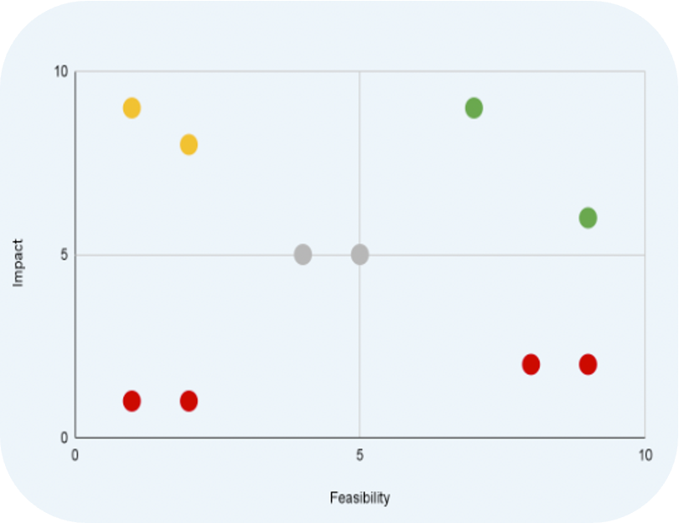
2
What can you do?
You need to weight Value and Frequency
Be careful of:
Optimism bias leading to planning fallacy
Sunk cost bias

Slide 16
Back to the use case.
You are working for a Fast Food chain and, knowing the company’s goal is to reduce customer churn,
you decided to analyze your customers using Mobility Data to better understand them

Slide 17

3
What do you know?
Your decision is as good as your data…
… and your data is probably fixed
Truth is complex and “one man’s garbage is another man’s transfer”
Footfall data with 30m precision:
Bad if you analyze 5m grids
Good if you analyze neighborhoods

Slide 18
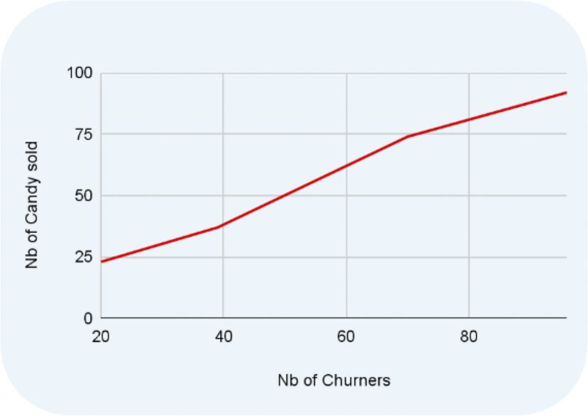
Correlation Trap.
Hypothesis:
Your candies are poisoned by your competitors, this poison creates an necessary urge to churn.
Churning is a way of life, and this includes a lot of candy eating.
Interesting
≠
Valuable → Twyman’s Law
Adopt a psychologist mindset and “humanize” the data.

Slide 19
Making a choice.
You classified your customer base into 3 personas:
To reduce churn you want to give your customers incentives.
Your analysis revealed that when compared to average consumers, churners spend less and visit your shops less.
1
Thea: is not loyal, spends the minimum and visits once a month.
2
Sofia: is loyal, spends above average and visits several times a week.
3
Alex: is average

Slide 20
Which one should be incentivized?
http://etc.ch/FgQP

Slide 21
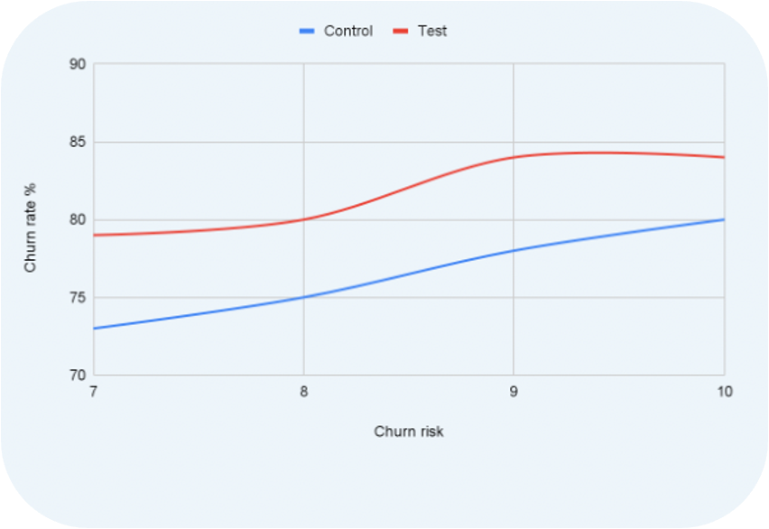
Research proves that…
Scored all the customers with a “churn risk”
Control: No incentive
Test: Incentive

Slide 22
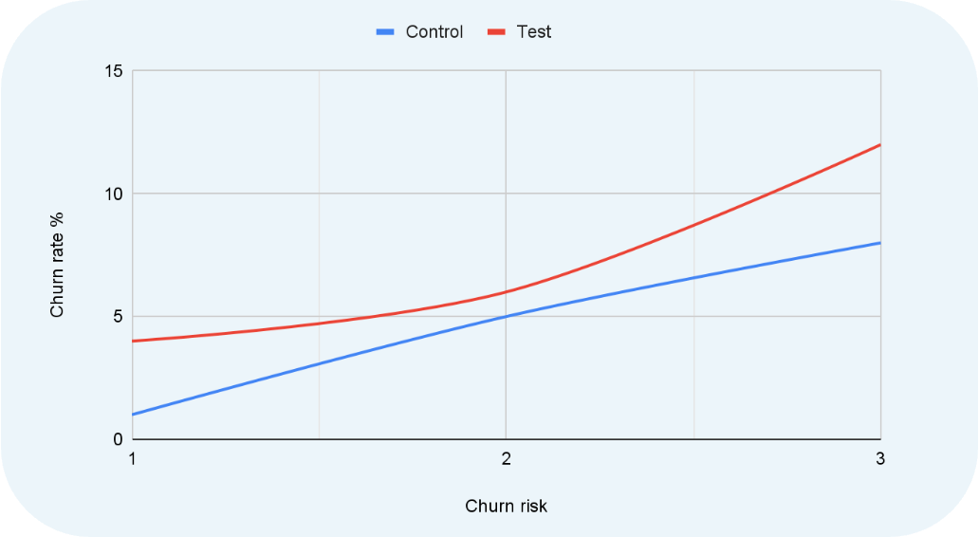
Research proves that…

Slide 23
Decision Focused Analysis.
Pre-test it:
If your experiment outputs Thea → We incentivize Thea
If your experiment outputs Sofia → We incentivize Sofia
If your experiment outputs Alex → We incentivize Alex
Data or analysis only has value if it can change decisions
Bad reasons
Value of information

Slide 24
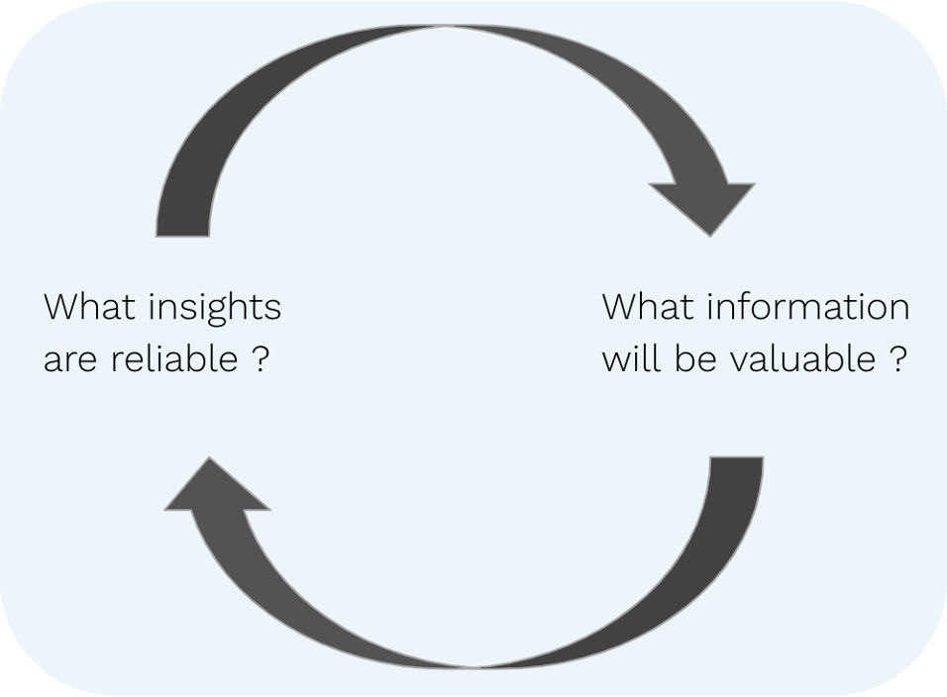
From Data to Action.

Slide 25
Summary.
A good analysis can change your decision
Remember what you need for a quality decision
A
WHAT
B
DO
C
KNOW
A good analysis creates: Impact = Value * Frequence
A good analysis weights: Impact vs Feasibility
Data and Dialogue lead from Data to Action

Slide 26

Join us tomorrow!
“
Navigating Cinema Advertising with Geospatial Data
”
11:05 AM - Columbia University
Kadir Karakus
Greg Scharer
Head of Data at Echo Analytics
Senior VP of Technology & Operations at NCM
Notes:
Kadir

Slide 27









Any questions?
Thank you.
Notes:
Kadir

